Slide 1
Product description
Meeting #9

Slide 2
The goal
This topic focuses on the features and benefits of consumer products and requires students to write their own product description

Slide 3
Features and benefits
Feature is a factual statement about a product
benefit is value or advantage customers get from product; positive outcome or result that will make them want to buy it

Slide 4
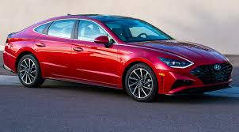
Product description of car
feature | benefits
ABS (Anti Lock Braking System | Safe braking and cornering
Alloy Wheels | Head turning good looks
3.01 V6 engine | Power on demand
Automatic climate control | Air conditioned comfort

Slide 5
Products and Packaging
Specification and feature

Slide 6
Vocabularies
Put the stages of product development into the most likely chronological order.
Beta test the product by users in typical situations
Conduct market studies to test the concept
Launch the product
Draw sketches and build mockups
Go into production
Draw up specifications for the product
Generate new ideas in focus groups and brainstorming meetings
Screen out unfeasible or unprofitable ideas

Slide 7

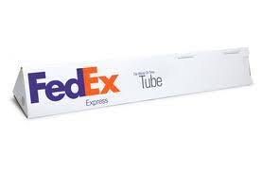
Read the information on the FedEx box and FedEx tube and complete the product specification
 | Inside dimensions For large Fedex box are Width x length x height (noun) 31.4 x 45.4 x 7.6 → The large fedexbox is 31.4cm in width and 45.4 cm in length. It is 7.6 cm in height →The large fedexbox is 31.4 cm wide and 45.4 cm long. It is 7.6 cm high
 | Inside dimension For Fedex tube are 96.5 x 15.2 x 15.2 Long wide high (adjective) → The fedex tube is 96. cm long ,and 15.2 cm wide and 15.2 cm high → The Fedex tube is 96.5 cm in length and 15.2 cm in height and width

Slide 8
Exercise!
Write product description of anyother kind of products, focus on benefits to consumer, adding any details you feel are appropiate.

